Slide 1
Notes:
Welcome the participants.
Introduce yourself, the CBA and the workshop.
The Canadian Bankers Association (CBA) has developed Your Money Seniors a part of their ongoing commitment to support the financial literacy needs of seniors across Canada.
The CBA is an association that supports the banking industry in Canada, and also provides information to help consumers manage their financial affairs. Additional assistance and support was provided by the Financial Consumer Agency of Canada, (FCAC). The FCAC is a federal government agency with a strong consumer education mandate and provides consumers with accurate and objective information about financial products and services and has a commitment to improving financial literacy among seniors.
Ensure that all participants can see the slides and hear you well.
Tell the group that the session will last about one hour.

Slide 2
Cash Management
MAKING THE MOST OF YOUR MONEY IN RETIREMENT
Notes:
Today we will discuss Cash Management in retirement, one of the three sets of the Your Money Seniors program.

Slide 3
Getting started
TODAY’S GOALS
Notes:
Let’s take a look at our goals for today’s session.

Slide 4
GOAL #1
How will your needs change over time?
Notes:
First, we’ll look briefly at how your financial needs will shift and change during retirement.

Slide 5
GOAL #2
Understanding income in retirement
Notes:
We’ll also look at income sources in retirement and learn a bit about how those work and how best to manage them.

Slide 6
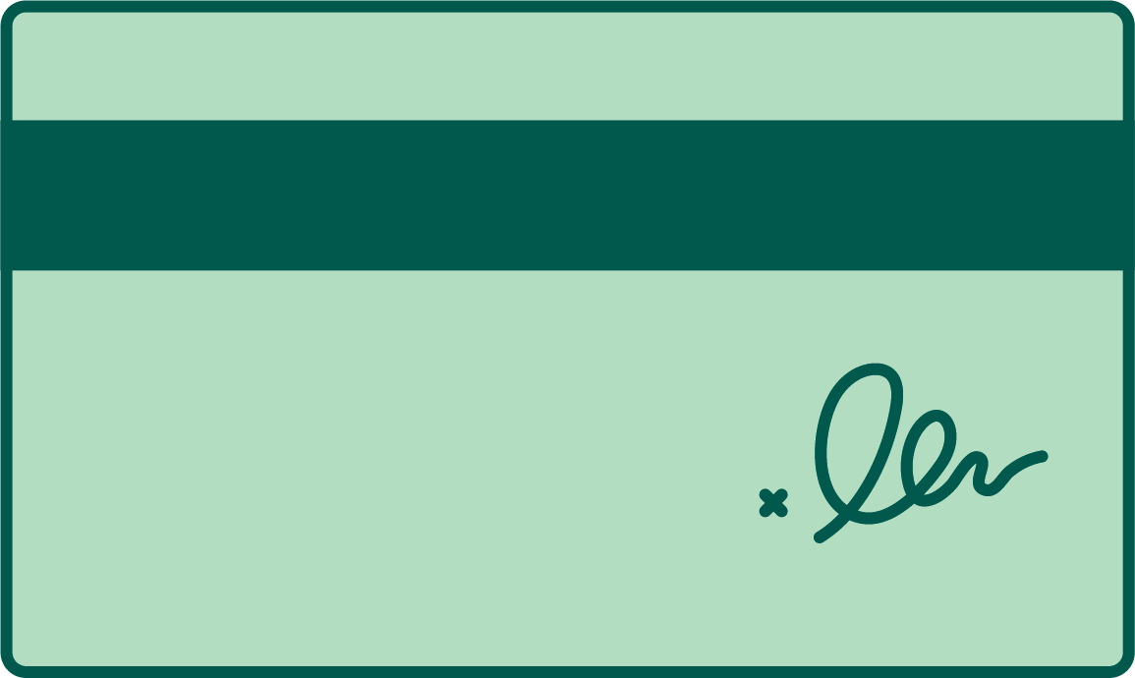
GOAL #3
Dealing with debt in retirement
Notes:
We will also learn about how to deal with debt in retirement.

Slide 7
GOAL #4
Expect the unexpected and prepare for a rainy day
Notes:
And how to save for a rainy day so you can handle emergency expenses.

Slide 8
Notes:
We Canadians are living longer lives - this is great news!!

Slide 9
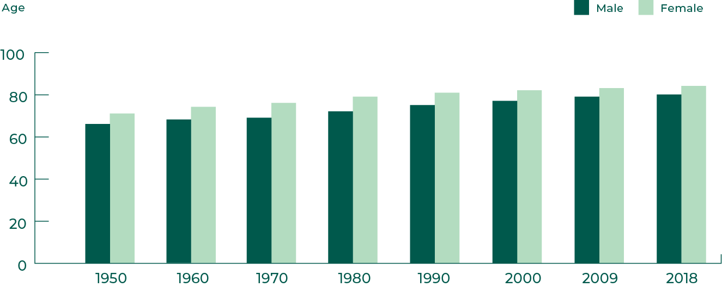
The good news
We’re living longer than ever – and we’re enjoying better health and a better quality of life!
Average life expectancy in canada
Notes:
Back in 1950 the average life span of a Canadian man was 66 and 71 for women. Today, however, the average man can expect to live to 80.9 while women live to 84.7. Canada’s world life expectancy is ranked at 7 (WHO, 2018)
And our lives are getting longer every year -- You now have a 58% chance of living beyond 85, a 40% chance of living past 90 and a 19% chance of living past 95.
That’s more than 10 years that have been added to our lives -- and it also makes the time we spend in retirement longer. Consider that today’s 65-year-olds can expect to spend an average of 25 years being retired.
This involves good things, like more time to pursue hobbies, be with your family etc.
But it also means we need more money to live on in retirement.
Not only do we need to save more before we retire, we also need to manage money very careful in retirement to make sure it doesn’t run out during our lifetimes.

Slide 10
Change is the only constant
What types of events change your needs and goals over time?
Notes:
Longer lives mean more time spent in retirement. So how can we make sure the money we have will last?
It means that we have to plan more -- and understand and envision (as best you can) what your life will be like during all those years you’re retired.
A lot can and will happen in those 15 to 20 years of retirement.
Just think about how your life has changed between now and 15 years ago - how many stages and experiences have you gone through?
How have your financial needs changed during that decade and a half?
Retirement, like your life before retirement, is not a fixed state. Your life doesn’t stand still when you retire - it changes. And some of these changes will directly impact your finances.

Slide 11
A lot can change in retirement
Health, age, capacity
Death of a spouse
Unexpected financial hardship
Notes:
What are some key factors or events that can change a person’s life -- and goals -- during retirement? Here are a few:
Health, age, capacity -- All these factors can change what your care needs are and whether or not you can live independently. For example, you or your spouse might become unable to live without care - one or both of you might need to move into a long-term care facility. Or you might get sick and require costly treatment or medication.
Death of a spouse
The death of a spouse is major emotional hardship for anyone.
It also affects your financial life. Many men and women can expect to experience a drop in income on the death of a spouse, whether it’s through estate taxes, loss of pension income or even loss of job income. And women in particular. Statistics Canada looked at the financial impact widowhood has on men and women over 65. It showed a couple of interesting things: 51% of widowed men suffered a loss of income after five years of widowhood while 72% of women suffered a loss after the death of a spouse.
Unexpected financial hardship
Other changes that can dramatically impact your finances in retirement come from unexpected events that cause financial hardship - for example, a large and unexpected expense like a flooded basement or a major expense like a new car to replace one that has broken down and can’t be repaired.
The important thing is to make sure that your finances in retirement can weather at least some of the major changes that life might throw your way. Doing this means talking to your spouse and to a professional advisor about ways to make sure you can handle change.
Insurance and estate planning are just some of the tools you can use to make sure that you’re ready for change in your retirement.
Remember: Change might be constant -- but you can plan for it.

Slide 12
What have we talked about so far?
1
2
3
Longer lives
Longer retirement
Lots of changes
Notes:
Any questions so far?
So, to recap -
The average man can expect to live to 80.9 while women live to 84.7.
This means we are spending 15 to 20 years longer in retirement.
We are also more active in our retirement years and we want to do more.
However, things can happen during our retirement that can change our lives -- and our finances.

Slide 13
Notes:
The big question you’re probably asking - how are we going to pay for it and how can we manage the money we have so that it lasts along the way.

Slide 14
Where will the money come from?
Investments
Public retirement benefits
Private pension benefits – workplace pensions, DB vs. DC
Other assets
Notes:
When you were working full-time your cash flow was relatively easy to predict - your paycheque came in and you used it to save and pay your expenses. Some of you might even have been lucky and received a bonus or raise every once in awhile to help cover extra expenses.
Income in retirement, however, is probably a bit more complicated than what you were used to when you worked full-time and lived on your earnings.
Why?
Because it comes from different sources - not just your employer.
So let’s take a look at some sources of income in retirement., including investments, public retirement benefits, private pensions and other assets.

Slide 15
Sources of retirement income
Investments
Stocks, bonds, mutual funds
Unregistered investments
Registered investments
Notes:
If you have money saved in investments like stocks, bonds or mutual funds then you need to find the best way to convert those savings into income.
If your investments are unregistered, then you will pay tax on any gains your investments have made when you take your money out.
But there are ways to minimize the tax you pay on your investments, particularly in years when your investments lost value. An advisor or accountant can help you do this more effectively.
If you have been saving your money in a registered retirement savings plan (RRSP), you can either cash it in, transfer it to a registered retirement income fund (RRIF) or buy an annuity. But, you have to this by December 31 of the year you turn 71.
Cashing in your RRSP means that you have to pay tax on all of your savings in the same year.
Instead, many people decide to withdraw it gradually through an annuity or RRIF to minimize the tax paid and stretch savings over a longer period of time.
If your money is saved in a Tax-Free Savings Account, then you can withdraw it any time without paying any taxes at all.
If you have questions about how Tax Free Savings Accounts work, the contribution limits, or any other questions about TFSA, you can check out the CBA’s website (there’s information in the handout) or talk to your financial institution.

Slide 16
Sources of retirement income
Public retirement benefits
Canada Pension Plan (and QPP)
Old Age Security
Guaranteed Income Supplement
Notes:
Another piece of the retirement income puzzle comes from public pension benefits:
Canada Pension Plan applies to all Canadians, except in Quebec where workers eligible for the Quebec Pension Plan (QPP).
The CPP provides pensions and benefits when contributors retire, become disabled, or die. It is designed to replace approximately 25 percent of the earnings on which your contributions were based over your working life.
You do not have to stop working to receive CPP but how old you are when you choose to begin receiving your CPP retirement pension has a major effect on the payments you will get for the rest of your life.
If you start your pension after age 65, you will increase your pension amount by 0.7% for each month that you delay receiving it after age 65, up to age 70 (that’s a 42% increase over the amount you would have received had you taken it at age 65).
Old Age Security (OAS) is a monthly payment available to most people 65 years of age. You can receive the OAS pension even if you have never worked or if you are still working.
You can also delay receiving your OAS pension and be eligible to receive more income - delay receiving your OAS pension and your monthly pension payment will be increased by 0.6% for every month you delay receiving it, up to a maximum of 36% at age 70.
You can delay your OAS for up to 60 months (5 years) after the date you become eligible.
*If you choose to defer receipt of your OAS pension, you will not be eligible for the Guaranteed Income Supplement, and your spouse or common-law partner will not be eligible for the Allowance benefit for the period you are delaying your OAS pension.
You have to apply for it - and you can receive up to a maximum of $551.54.
The Guaranteed Income Supplement is another public pension benefit available to Canadian seniors provided they meet the requirement, including being low income.

Slide 17
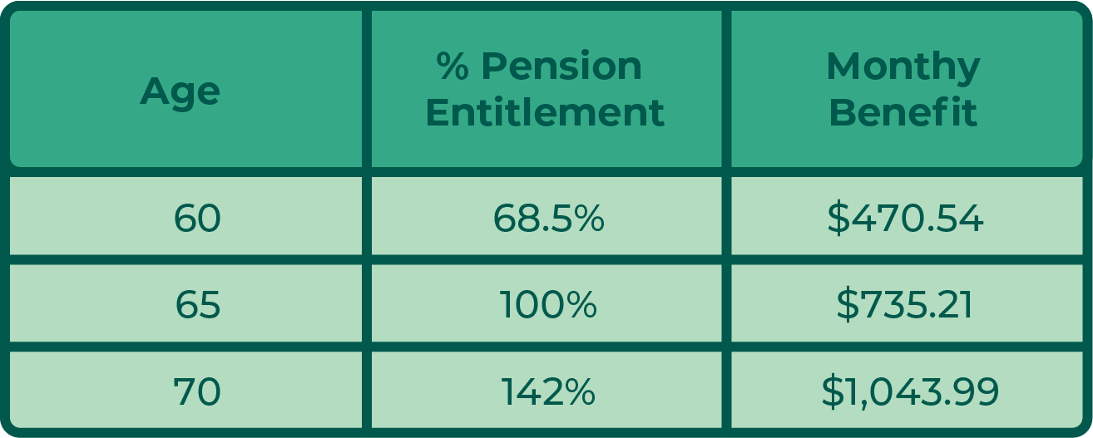
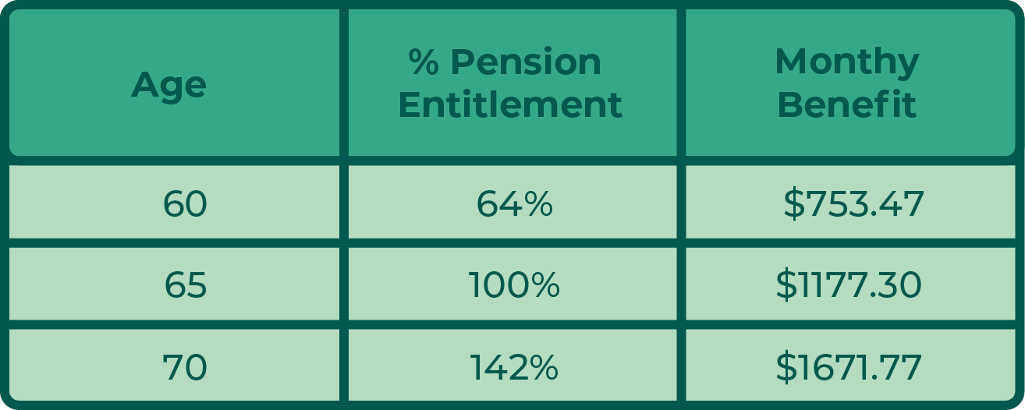
CPP Average
Waiting can be worth it...
QPP Average
OAS Average
Notes:
To see just how much more money you can get by deferring your OAS and CPP/QPP …
These graphs show you how much more money per month you are entitled to if you can hold off on collecting OAS and CPP/QPP :
OAS – deferring OAS five years can mean the difference between $6,618 a year and $9,001 on average.
For CPP, as this chart illustrates, you could take CPP at age 60 or wait until 65 and take it at $735.21 per month. The maximum monthly amount you could receive as a new recipient starting the pension at age 65 is $1,175.83. If you start receiving your pension earlier, the monthly amount you’ll receive will be smaller. Or you can wait until 70. Ultimately, there is no benefit to wait after 70 to receive the pension. The maximum monthly amount you can receive is reached when you turn 70.
* To clarify, the average amount you receive for your CPP is based on your average earnings throughout your working life, your contributions to the CPP, and the age you decide to start your CPP retirement pension.
For QPP, as the chart illustrates, you could take QPP at age 60 and be entitled to $753.47/ month or wait until 65 and take it at $1177.30 per month. Or you can wait until 70 and be entitled to receive $1671.77 a month. A significant difference depending on how long you can wait to draw down on these benefits.
Note - these are all based on averages - you would need to do your own calculations based on your situation

Slide 18
Sources of retirement income
Workplace pensions
Defined benefit plan
Defined contribution plan
Other assets
Income from your home
Notes:
If you have a workplace pension, then you are likely receiving an income from it. How much you get depends on how much you paid in and it can depend on what type of plan you had.
If you have a defined benefit (DB) plan, then the amount you receive will be fixed and your employer will ensure you receive regular payments in retirement.
If you have a defined contribution plan (DC), then you need convert this to savings by buying an annuity or an income fund.
Any questions so far?

Slide 19
What have we talked about so far?
1
In retirement, you have multiple sources of income
2
You must convert RRSP to RRIF by age 71
3
You need to apply for CPP, OAS, GIS
4
Waiting until 70 for CPP/OAS means you get more
5
Your house can earn you income
Notes:
You might also have other assets that you can convert into income. Probably the biggest asset for many people is their home.
Income from your home - If you own a home, there are many ways to draw an income from this asset. You could rent out part of it - a room or a floor of the house to generate rental income. You could also consider borrowing money against the value of your home through a home equity line of credit or a reverse mortgage, which will allow you to tap in to the equity you have built up in your home.
I’d like to recap what we’ve learned so far:
In retirement, you have multiple sources of income
You must convert RRSP to RRIF by age 71
You need to apply for CPP, OAS, GIS
Waiting until 70 for CPP/OAS means you get more
Your house can earn you income

Slide 20
Notes:
When we think of retirement we think about time spent not working - and instead pursuing golfing, gardening or other hobbies. But the reality is a lot of people continue working past the traditional age of retirement.
Did you know that 1 in 5 Canadians aged 65 or older returned to work at some point during the year including 5.9% who did so full year, full time. In 2015, employment income was the main source of income for 70.3% of seniors who worked full year, full time, up from 62.1% in 2005 and 56.7% in 1995 (Statistics Canada).

Slide 21
Do you plan to keep working in retirement?
Implications for public pension benefits
Tax
Notes:
Can you think of any famous people who are still working over 65?. Examples - Warren Buffett, Judi Dench/Clint Eastwood, Don Cherry….
Some people even find new careers and success in retirement
If you are planning to work in retirement you do need to understand how it might impact the public benefits you receive and possibly even your private pension benefits if you receive them.
For example, if you earn more than a certain amount, it could reduce some of your benefits -- for example the OAS pension. Once your income is over a certain amount, the value of your OAS pension is reduced at a rate of 15 cents for every dollar of income over this amount.
You can work while you receive public benefits like Canada Pension Plan - you and your employer will still have to make contributions, but those contributions will increase the amount you are paid later on.
You could also use your working income to delay payments of OAS and CPP until you are 70 and receive more.
You can find more information on working and public benefits through the Financial Consumer Agency of Canada and the link to their website is in your handout.

Slide 22
DEALING WITH DEBT
Did you know?
1 in 3 retirees in Canada hold some form of debt.
Notes:
Debt is a fact of life these days and it’s become much more acceptable to carry debt and with low interest rates it’s become relatively cheap to carry
Not surprisingly, more and more seniors are carrying debt into retirement (refer to statistic - over 60% of retired Canadians have debt)
Debt includes mortgages, credit cards, and lines of credit.
The problem with debt in retirement, however, is you have a fixed income, which makes it hard to make big payments to get rid of debt.
Paying the debt has to be built into your budget.
Another big risk…if interest rates increase the cost of credit increases and so would your payments.

Slide 23
Rising rates and the cost of debt
Source: Financial Consumer Agency of Canada
Notes:
Just a small increase in rates (even half a percentage point) can push your monthly payments up substantially. Those increased costs can eat into other important areas of your budget - food and shelter. And it can make it harder to make ends meet.
So if you do have debt, you should talk to your lender about how much your payments would go up if rates were to rise.
And you should make sure that you have a cushion for coping with increased payments -- if not, then you might want to make a plan for getting rid of the debt faster.

Slide 24
7 tips for managing debt
1
Make bigger payments
Pay off most expensive debt first
2
3
Consider consolidating
4
Negotiate
5
Find extra money
6
Credit counseling
7
Get help – talk to your bank early
Notes:
We’ve seen the impact rising rates can have on your monthly payments -- and that debt has some risks for retirees without the extra money to handle an increase in monthly payments.
What can you do to better manage your debt?
Here are seven tips to get you started. You want to:
Make bigger payments -- Don’t just make the minimum payment - pay as much as you can.
Pay off most expensive debt first - i.e., credit cards, department store cards (those with the highest interest rates)
Consider consolidating - Check whether a consolidation loan from your bank might be less costly, and if you can arrange one you only need to make one payment
Negotiate - call your bank or credit card company and ask for a better rate to help you shed your debt faster
Find extra money - Do you have a budget? Go through your monthly expenses and find anywhere you can cut back to free up cash for paying off your debt faster (i.e., cut out your takeout coffee and you can free up $50 a month to put towards your debt).
Talk to your bank early - If you’re struggling, talk to your bank and your other creditors to discuss the situation and find out if there are options to help you pay off your debt. Banks are willing to be flexible and help customers make alternative arrangements to repay the money they owe to their bank.
Get help - If you can’t manage your debt contact a not-for-profit credit counseling agency for help – to find an agency in your area, call or visit the website of either Credit Counselling Canada or the Canadian Association of Credit Counselling Services. There is contact information for both organizations in your handout.

Slide 25
What have we talked about so far?
1
2
3
Working in retirement can add income and help defer CPP/OAS payments
Rising interest rates are a risk for retirees with debt
It’s important to make a plan to manage debt
Notes:
Any questions so far?
Here’s what we’ve discussed:
Working in retirement can add income and help defer CPP/QPP and OAS payments
Rising interest rates are a risk for retirees with debt
It’s important to make a plan to manage debt

Slide 26
Notes:
I said before that change is the only constant - some change you can plan for - others, life throws at you. A leaky roof, a car accident, a health crisis - these are only a few of the curveballs life can throw at you -- and they can affect us financially if we’re not prepared.
Discussion: Ask the group to discuss the types of unexpected expenses that may arise. Draw from the following examples:
Repairs to your home
Appliance breaks down
New vehicle required or repairs to a vehicle
Decline in health and costs associated with medications/ health aids/personal care assistance/living costs
Market fluctuations
Need to move to assisted living – this can happen very quickly – so need to have a plan in advance
What would be the implication on your finances if one of the unexpected happened? How would you manage it – because planning for the unexpected is key to managing your finances in retirement. The group can be asked to put approximate price on each – some are more serious than others (i.e. health status compared to new appliance!)

Slide 27
Four ways to prepare for the unexpected
1
2
Save – and save smartly
Do your paperwork
3
4
Make a plan
Consider insurance
Notes:
Save - The first and best think you can do is to make sure you’re ready for a rainy day - and that means saving. Put aside some extra money to help you cover a major expense during retirement. You can also talk to your bank and make sure you’re covered by a line of credit in case you need money fast (although be careful: that could end up adding debt that you might not be able to pay off easily).
AND - be smart about how you save. Tax free savings accounts for example are a great way to save money - money in a TFSA grows tax-free, meaning when you take it out you don’t pay an tax on interest or investment earnings.
Another smart way to save is to automatically take money out of your chequing account and to put it in a separate savings account that you can’t get to easily (that way you won’t even notice it’s gone!)
Do your paperwork - Ensure you have Power of Attorney (POA) for property and health in place – obtain legal advice to ensure properly drafted.
Make a plan - Make sure that your need for emergency savings is reflected in your overall budget - if you don’t have any money to cover an unexpected expense, then you can cut back in some areas to build your emergency fund.
Consider insurance - Also consider that, in retirement, you may not have the private health coverage that you had when you were employed, unless you purchased separate health insurance. You need to consider possible costs related to health.

Slide 28
1
Helpful links
Canadian Bankers Association
www.cba.ca
2
Financial Consumer Agency of Canada
www.canada.ca/fcac
3
CBA Fraud Prevention Tip Newsletter: sign up at
www.cba.ca/fraud
Notes:
That about takes care of the Cash Management information. I did want to share with you that there are three modules in the Your Money Seniors program.
You’ve heard from me today about Cash Management in Retirement, and we also have Your Money Seniors presentations on:
•Financial Abuse: Protecting Your Money and Yourself which outlines that different types of financial abuse that can occur when somebody tries to take or control something that belongs to you whether that’s money, property or personal information. This seminar also talks about the risks of Powers of Attorney and joint accounts and provides really good information on how to spot this type of abuse.
•Financial Fraud: Know the Signs and Empower Yourself will help you recognize the different kinds of financial fraud including identity theft, debit and credit card fraud, internet, phone and email scams and gives you tips and information to prevent fraud from happening to you.
All Your Money Seniors seminars are free and available throughout the year and you can talk with your group’s organizer about requesting another seminar.
The Your Money Seniors website at www.yourmoney.cba.ca is also a really good resource for more information on what we’ve talked about here today.
The CBA also sends out a monthly fraud prevention tip email newsletter. You can sign up here: www.cba.ca/fraud

Slide 29
We hope you enjoyed the seminar!
Let us know what you think.
http://cba.ca/seniors-survey-cm
Notes:
We would really like to know what you think. If you could pull out your phone and complete the seminar evaluation form, I’d really appreciate it, thank you.

