Slide 1
Notes:
Welcome the participants.
Introduce yourself, the CBA and the workshop.
The Canadian Bankers Association (CBA) has developed Your Money Seniors a part of their ongoing commitment to support the financial literacy needs of seniors across Canada.
The CBA is an association that supports the banking industry in Canada, and also provides information to help consumers manage their financial affairs. Additional assistance and support was provided by the Financial Consumer Agency of Canada, (FCAC). The FCAC provides consumers with accurate and objective information about financial products and services and has a commitment to improving financial literacy among seniors.
Ensure that all participants can see the slides and hear you well.
Tell the group that the session will last about one hour.

Slide 2
Financial Abuse
PROTECTING YOUR MONEY & YOURSELF
Notes:
Today we will go over the Financial Abuse module, one of the three sets of the Your Money Seniors program.

Slide 3
Getting started
TODAY’S GOALS
Notes:
Today, I have four main goals for the seminar.
They are to

Slide 4
GOAL #1
Define financial abuse

Slide 5
GOAL #2
Learn how to recognize the signs

Slide 6
GOAL #3
Understand how to prevent it

Slide 7
GOAL #4
Know where to get help if it’s happening to you
(or someone you know)

Slide 8
Notes:
Let’s start with a short quiz that will help us to become more familiar with today’s topic.
Let’s look at the following scenarios and decide which might be red flags for financial abuse.

Slide 9
Which is a red flag of financial abuse?
You live in your own home but your adult daughter wants you to have your bank statements sent to her
A neighbour, also a contractor, wants to do some work on your house but won’t give you an exact quote for the work
Your nephew is pressuring you to sign documents that give him power of attorney but you are feeling unsure about the choice
All of the above
Notes:
How many thought the first point could be a sign of financial abuse? Could sending bank statements to a family member open up potential for abuse?
How about the second one? A contractor wanting to do work without a quote? Do you think that it could also offer potential for abuse?
How about the third? How many of you think that being pressured to sign documents is a red flag for financial abuse?

Slide 10
Which is a red flag of financial abuse?
You live in your own home but your adult daughter wants you to have bank statements sent to her
A neighbor, also a contractor, wants to do some work on your house but won’t give you an exact quote for the work
Your nephew is pressuring you to sign documents that give him power of attorney but you are feeling unsure about the choice
All of the above
Notes:
If you thought all were potential signs of financial abuse you would be quite right.
Any of these situations offer the possibility of financial abuse.

Slide 11
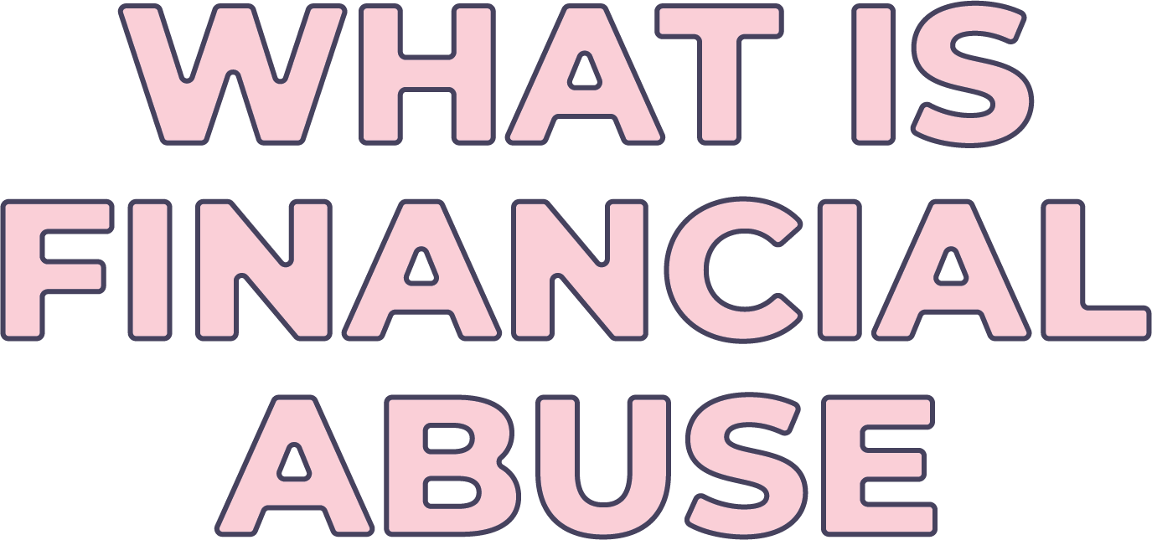
Notes:
Now - let’s talk about what financial abuse means.

Slide 12
What is
financial abuse?
Financial abuse occurs when someone tries to take or control something that belongs to you.
That may include money, property or personal information.
It is unethical and in many cases illegal.
Notes:
Financial abuse occurs when someone tries to take or control what belongs to you for their own benefit, not yours. This can include your money, your property, or your personal information. Financial abuse is unethical, and in many cases it is also illegal.
Context: let’s look at some examples to make it real.
Your granddaughter borrows some money but refuses to pay it back;
An acquaintance asks to move into your home and refuses to pay rent;
A niece or nephew is trying to pressure you to sign a document you don’t understand;
All these could be examples of financial abuse. Financial abuse is usually perpetrated by someone you know.
I want to make this clear. Financial abuse and financial fraud are two different things. Your Money Seniors also has a module on financial fraud that explains how you can spot frauds and scams. Financial abuse, by contrast, is illegal and unethical behaviour on the part of an individual who wishes to control what belongs to you for their benefit.

Slide 13
Seniors are more at risk of financial abuse. Why?
Usually have fixed incomes making it hard to recover from their loss through earnings
Many seniors must depend on others for support
Many seniors are more isolated making it hard to get help
Financial abuse can have a negative impact on health
Notes:
Now that we know what financial abuse is and we’ve talked about some examples, why do you think seniors are more at risk for financial abuse than others in the community?
(You can ask for input and discussion on any of the factors in the slide and use it as an opportunity to engage the participants.)
Factors to cover during discussion:
Finite financial resources – when you are on a fixed income, stolen money or possessions impacts your quality of life – sometimes for the rest of your life. It’s not just about the money - it’s about quality of life. People on a fixed income have a harder time making up for losses.
Dependency - As people age, they become often more dependent on people for support and assistance in their lives – professional caregivers, family members, and friends are placed in positions where they have access to and/or control over a senior’s home, money and possessions.
Isolation - Seniors are sometimes isolated by health, death within their circles, and mobility issues - this makes it hard for some to reach out to experts or other trusted people for advice making them vulnerable to financial abuse.
Money and health are linked -- Losing money through financial abuse can have an impact on your ability to stay healthy.
We can clearly see how devastating financial abuse can be for an older person and the importance of recognizing the signs and ways to prevent it from happening.
Now we have talked about the definition of financial abuse and why seniors are more at risk than some others in the community, we will talk about how it happens.

Slide 14
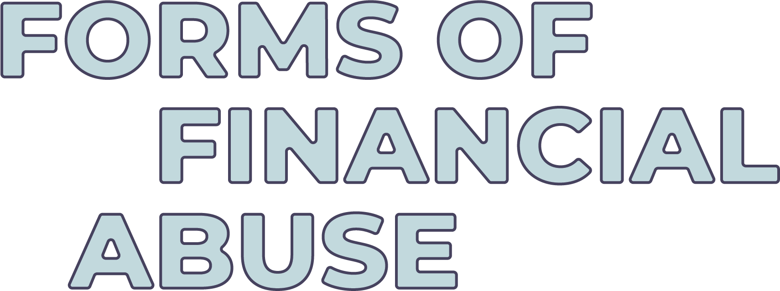
Notes:
We know what financial abuse can do – so how does it happen? What are the top forms that financial abuse can take? Let’s look at Power of attorney and joint accounts – two important financial tools that can be very helpful when used properly but are also expose seniors to a risk for financial abuse.

Slide 15
Forms of financial abuse
Power of Attorney (POA) – Property
A legal document that gives someone the authority to act on your behalf with respect to financial matters.
Notes:
First, let’s talk about Power of Attorney, or POA, – it is a very important tool for a senior to have in place – in case of illness or incapacity. You don’t want to be worrying about what will happen to your finances if you can’t manage them yourself and having a POA in place can help with that.
However, it is also something that can be abused.
If you have a will, you might have a power of attorney - A Power of Attorney (POA) is a legal document that gives someone else (one or more persons) the legal right to act on your behalf.
It’s important to understand that the term ‘’Attorney’’ does not mean “lawyer” or “Attorney at law”. Most people appoint a trusted person or persons such as family members or friends to act as their Attorney(s) under a POA. A general POA gives the Attorney complete access to your bank account and other finances. It can also give them the power to do things like sell your home or other assets, sign agreements on your behalf and generally act on your behalf on all legal matters. The decision to assign somebody POA over your financial affairs should not be taken lightly.
The names and requirements for the different types of powers of attorney that deal with finances and property will vary depending on the province or territory where you live. Generally, there are two main types of powers of attorney commonly used for finances and property in Canada.
A Power of Attorney can be a continuing or enduring POA that remains valid if you become incapable of conducting your own affairs. Remember that you can revoke an existing POA and appoint a new Attorney at any time. You may want to do this if you have concerns about the way your Attorney is acting for you, or if your situation changes and you think the person who is currently your Attorney is no longer suitable. Or the current Attorney may no longer be available to act for you. If you revoke your POA, you need to tell your bank so they can update your records to reflect your choice. If you move to a different province or territory or outside of Canada, your existing POA may not be valid in that new location, so you may need to seek local legal advice and have a new POA prepared that meets the local requirements.
There is another type of power of attorney for health matters that I will not address here but allows a designate to make decisions around your health if you are incapacitated.
People who have power of attorney for your property have, as the title suggests, a lot of power.
Financial abuse occurs when that power used to benefit the Attorney (not you).

Slide 16
What to consider when choosing a POA
Personal Suitability
Availability
Trustworthiness
Reliability
Experience
Willingness
Notes:
When choosing a POA, it is very important to ask someone you trust. You can appoint anyone as your attorney: spouse, family friend or family member. Remember you are giving this person the right to manage your money and properties, so make sure you pick the right person who will have your best interest.
What to consider when choosing a legal attorney:
-Personal Suitability
-Trustworthiness
-Experience
-Availability
-Reliability
-Willingness
The minimum legal age for an attorney varies according to the province or territory where you live, so you will want to make sure you verify the legal age for where you live.
You should also consider appointing a substitute attorney in case the first attorney can no longer act for you.
For more information on Power of Attorney, you can visit the Government of Canada website (https://www.canada.ca/en/employment-social-development/corporate/seniors/forum/power-attorney-financial.html)

Slide 17
Forms of financial abuse
Joint Bank Accounts
Holding funds in an account with another person – both persons are legal owners of the funds and have full access to those funds.
Notes:
How can a joint account be a risk?
A joint account is an account under two names – both people have access to the funds and it is considered a joint asset.
Opening a joint account may be one way to have someone help you pay bills and manage your money – but there are risks. If you open or make existing accounts joint with a family member or caregiver to make it easier for that person to assist with paying bills, etc., or for estate planning purposes to avoid probate fees, you make that person a co-owner of the funds in the account.

Slide 18
Forms of financial abuse
Joint Bank Accounts
This can be harmless if the other person is trustworthy but if not, the funds can be used by the other person for their own benefit not yours.
Notes:
This arrangement may be harmless if the other person is trustworthy and follows your wishes. But, if not, an abuser can take over the funds in a joint account and use them for their own benefit, not yours.
It is important to know that you have essentially given shared ownership of your funds to the other person;
The funds in a joint account are considered a joint asset. So, if the joint account holder is sued or has a previous legal judgment or garnishment order against them or is engaged in a family law proceeding, your funds may be considered part of their assets and could be at risk;
If there is a need to have someone pay bills and manage money on your behalf, there may be better options to use than a joint account. For example, you could use a Power of Attorney to allow you to retain ownership but allow the other person to do transactions for you; or you can establish an account to which you transfer only enough funds that the joint account holder needs to pay your bills and/or expenses. Perhaps talk to your bank about other options.
POA and joint accounts are two things that hold potential for abuse. It is crucial to ensure you are protected!
But there are other forms that abuse can take. Let’s take a few moments to look at those.

Slide 19
Other forms of financial abuse
Theft of money or possessions
Forging of signatures on legal or financial documents
Exerting undue pressure to sign legal or financial documents
Exploitation by service providers
Individual refusing to return borrowed items/money.
Notes:
It is important to have an understanding of all forms of financial abuse to help protect yourself or your friends and family.
There are other forms of financial abuse – some of which are more straightforward and clear than others.
Theft -- either of your money or your possessions. Theft is pretty straightforward – we include it here because it may not be a stranger who steals from you it could be someone you know well.
Forging your signature on financial documents - forging signatures may be harder to detect because you may not know immediately that it has occurred. The documents may be a will or a POA, or a cheque.
Tricking you or forcing you to sign a contract or legal document (i.e., Will or Power of Attorney)
Refusal to return borrowed property or money. For example: A family member of friend may borrow a car or money and then refuse to return it to you.
Exploitation by service providers (overcharging, doing unnecessary work) For example: a contractor comes in to do some painting in your home – perhaps they want all the money upfront and don’t finish the job, or perhaps the price at the end of the work seems quite a bit higher than what you expected.
There are many forms of financial abuse and all are upsetting and many are illegal. Let’s take a few moments to recap what we have talked about so far.

Slide 20
What have we talked about so far?
What is financial abuse?
Why is financial abuse a concern?
What it looks like.
How it can happen.
Notes:
Any questions so far?
Financial abuse is when someone tries to take or control something that belongs to you and use it for their own benefit. We know that financial abuse can be financially devastating especially for seniors who live on a fixed income and can’t recover their losses through earnings. We also learned that it can take many forms including misuse of a POA or joint account or perhaps a theft. And we also know that financial abuse is almost always perpetrated by people you know.

Slide 21
The faces of financial abuse
Notes:
When we look at this list we see why financial abuse can be so devastating not only financially but emotionally. It is most often people you know – a family member, caregiver or friend who are responsible for financial abuse. Most importantly it is someone you trust, and that trust has been broken.

Slide 22
Who could be a financial abuser?
A family member
A caregiver (family/professional)
A neighbour/friend
A service provider or contractor
Notes:
People with access to your home or finances could include:
A family member - a spouse, adult child, grandchild or other family member
A caregiver (nurse or staff at nursing home)
A neighbor/acquaintance who gains your trust
Service providers (contractors, handyman)
Discussion - who else might be in a position to exploit a senior financially?
Now we’ll take a look at these three scenarios and I want you to think about the red flags for financial abuse in each of these stories.

Slide 23
Meet Julia

Slide 24
Notes:
Play video
https://www.youtube.com/watch?v=b7O6ObEsj9I&t=8s

Slide 25
Meet Randall

Slide 26
Notes:
Play video

Slide 27
Meet Anton

Slide 28
Notes:
Play video

Slide 29
DISCUSSION
What do you think these three scenarios have in common?
What are the red flags of financial abuse?
Notes:
Discussion – What do you think these three scenarios have in common? What are the red flags for financial abuse?
All three people in these scenarios have a few things in common. They are generally isolated (no close family living with them), several are beginning to have health issues, and all have suffered from loss of money and property.
We are going to talk about what Julia, Randall and Anton could do to help themselves and perhaps what they might have done to prevent these situations.

Slide 30
Notes:
There were warning signs that we will now talk about that might help someone you know avoid financial abuse.

Slide 31
Potential signs or red flags may include:
Sudden change in living arrangements
Abrupt or sudden change of beneficiary
Confusion about how money is spent or missing money
Items are missing from the home
Notes:
We know how financial abuse takes place and who potential abusers can be -- we’ve also met some of the victims. But what are the signs we should be looking out for when it comes to spotting cases of financial abuse -- whether you are the victim or whether you see it happen to anyone else.
Let’s start with “sudden change in living arrangements”.
Usually, it takes some planning to organize a move to a retirement home or to have an individual move in. In a case of financial abuse, the move out of the home and its sale immediately afterwards might be a reason to ask questions. There may be a reasonable explanation such as a move to a retirement home but it could also be a possible sign of abuse. Always a good idea to ask questions if you are unsure.
Second, if your friend or family members shares that they are feeling pressure to change beneficiaries or change their Power of Attorney, will, or title on property, then we have a red flag.
Perhaps an even more blatant red flag could be that money is being taken from a bank account or unauthorized charges are appearing on credit card statements.
And perhaps a friend or family member confides that things are being taken without permission. Perhaps a car has been borrowed by a family member and not returned.

Slide 32
Potential signs or red flags may include:
Costly/unnecessary repairs or purchases
Newly created joint account with acquaintance
Unpaid bills/short of money
Pressure to sign documents the individual does not understand
Notes:
Other red flags may include, a neighbor, friend or family member reporting very expensive repairs to their home. They may report being surprised at the cost. You may be taken aback that these repairs or work is necessary on their home.
Perhaps, you know an individual that has opened a joint account with someone who has just recently become involved in their lives or has legal/financial troubles.
Your friend/family member may be uncharacteristically short of money – and may express concern that their bills aren’t being paid. It may be worth asking some questions.
If you or someone you know are feeling pressured to sign documents you don’t understand that is a big red flag for financial abuse. If you see a red flag for financial abuse, it is time to ask questions and seek help.
So what do you do if you suspect financial abuse is happening to yourself or someone you know?

Slide 33
What to do if you
suspect financial abuse?
Tell someone
Get help
If it relates to your bank account – tell your bank/financial institution
Take steps to get some distance from abuser
Notes:
We are now familiar with some of the telltale signs of financial abuse, but what should you do about it?
If you think you’re witnessing financial abuse or that you’re a victim of abuse, here is what you can do:
Tell someone - talk to someone you trust and tell them what is happening - a lot of people are too embarrassed to tell anyone (like Randall). Telling someone is your first step in stopping the abuse.
Get help - call the police, a lawyer, or a local senior’s centre to find out who can help you deal with the abuse.
A POA can be revoked and you can demand a full accounting of all financial transactions.
Tell your bank/financial institution - If someone is taking money from your bank account or misusing your credit cards, let your bank know. They can help shut down that activity.
Get distance - remove the abuser from your home and change the locks if someone has a key.
Refer to the resource list on the back of the handout, separated by province

Slide 34
REMEMBER
Financial abuse is a violation
of an individual’s rights.
It is not your fault.
You can get help!
Notes:
Financial abuse is a violation of an individual’s rights. It is not your fault. You can get help.

Slide 35
Where to get help
Other family members
The Canadian Anti-Fraud Centre
The police
Your bank or financial institution
Notes:
Other family members may be able to help.
There are organizations across Canada, such as the Canadian Anti-fraud Centre who can help you and there is a list of provincial resources in your handout.
The police. Reporting to the police will help them keep track of the number of cases.
Your bank or financial institution can help but have limits on what they can do depending on the situation. It is important to ensure that you access help from your bank and others.

Slide 36
Key tips for preventing
financial abuse
1
Carefully choose a trusted person to be your Attorney
2
Get legal advice to ensure your interests are protected
3
Protect your PINs that access your financial accounts
4
Consider alternatives to a joint account
Notes:
The very best way to deal with financial abuse is to prevent it from happening in the first place. And there are steps you can take to protect yourself. Here are a few of them:
Choose a trusted person to be your Attorney – remember an attorney is someone you give the authority to act on your behalf with respect to financial matters. Be clear with your attorney about your wishes. Understand how POA works and what it means before you sign.
Don’t be pressured into signing documents without consulting a trusted expert (i.e. Lawyer) or someone you trust – involve them in your financial decisions.
Protect your PINs - never give away your PIN numbers on your financial accounts – don’t write them down where others can find them.
Stay in touch with your bank and consult with your bank when making important decisions around joint bank accounts or giving someone else the authority to do your banking for you. At home, keep valuables, ID and credit cards/cheques in a safe place only you can access.

Slide 37
Key tips for preventing
financial abuse
5
Open and check your mailed bank, investment and
credit card statements yourself
6
Ensure that financial and legal documents are kept in
a safe and secure place
7
If you loan someone money or a possession make sure
it is in writing
Notes:
5. Open your own mail and pay your own bills for as long as you can -- also, check your bank and credit card statements carefully every month for transactions you didn’t do. You can also monitor your accounts or credit card transactions by telephone.
6. Keep all of your important financial and legal documents in a safe and secure place.
7.Write it down - If you are lending or giving money or a possession to someone, keep a record – preferably have a formal written agreement that the borrower signs.

Slide 38
RECAP
What to do and ways to prevent financial abuse
What to do if you suspect financial abuse.
Tools and tips for preventing financial abuse.
Notes:
Let’s review what do if you suspect financial abuse. Who can tell me one action that you can take if you suspect abuse?
Note: the discussion should include tell someone; contact financial institution or call police.
Let’s review prevention. What are some ways we can help to prevent financial abuse?
The discussion should include: choosing a trusted person for POA, keep track of bank accounts and credit card statements; protect PINs; keep cheques and other documents in a safe place.
Any questions so far?

Slide 40
Which of the following situations
are red flags of financial abuse?
Individual opens a joint account with an individual
they do not know well
Individual reports being pressured by a family member into signing documents they don’t understand
Individual has paid an unusually high amount for
a home repair or service
All of the above
Notes:
Let’s take a few moments to go over this quiz on red flags.
Which of these situations offer the potential for financial abuse?

Slide 41
Which of the following situations
are red flags of financial abuse?
Individual opens a joint account with an individual
they do not know well
Individual reports being pressured by a family member into signing documents they don’t understand
Individual has paid an unusually high amount for
a home repair or service
All of the above
Notes:
Yes, all of the above – this list includes some of the red flags we talked about today. All of the situations listed above merit further questions or discussion. They may well not be financial abuse but there are all situations that offer the potential for financial abuse.

Slide 42
What to do if you suspect financial abuse?
Call police
Inform bank or financial institution
Get help
All of the above
Notes:
What about this quiz? What to do if you suspect financial abuse?

Slide 43
What to do if you suspect financial abuse?
Call police
Inform bank or financial institution
Get help
All of the above
Notes:
Yes, all of the above – it depends on the situation but any of the possibilities on the list are a good option if you suspect financial abuse.

Slide 44
1
Helpful links
Canadian Bankers Association
www.cba.ca
2
Financial Consumer Agency of Canada
www.canada.ca/fcac
3
CBA Fraud Prevention Tip Newsletter: sign up at
www.cba.ca/fraud
Notes:
To wrap up, I’d like to thank you for coming today and to leave you with one financial key piece of information. Financial abuse, if it happens to you, is a violation of your rights. It is not your fault, and you can get help.
I did want to share with you that there are three modules in the Your Money Seniors program.
You’ve heard from me today about how to protect yourself against financial abuse, and we also have Your Money Seniors presentations on:
•Cash Management and making the most of your money in retirement which discussed the changing needs you will have throughout your retirement and how to plan for them, and
•Fraud Prevention: Know the Signs and Empower Yourself, which will help you recognize the different kinds of financial fraud including identity theft, debit and credit card fraud, internet, phone and email scams and gives you tips and information to prevent fraud from happening to you.
All Your Money Seniors seminars are free and available throughout the year and you can talk with your group’s organizer about requesting another seminar.
The Your Money Seniors website at www.yourmoney.cba.ca is also a really good resource for more information on what we’ve talked about here today.
The CBA also sends out a regular and free fraud prevention tip email newsletter and you can sign up at www.cba.ca/fraud.
Thank you again and I’d be happy to answer any questions.

Slide 45
We hope you enjoyed the seminar!
Let us know what you think.
http://cba.ca/seniors-survey-fa
Notes:
We would really like to know what you think. If you could pull out your phone and complete the seminar evaluation form, I’d really appreciate it, thank you.

